Slide 1

CT&DT-SPSU-"ANONYMOUS"-TASK#11
UNIQUE CHARACTERISTIC OF DESIGN THINKING EMPATHY PROCESS FLOW

Slide 2

PRODUCT :- SAMSUNG GALAXY NOTE 7
Samsung Galaxy Note 7 when it was released in 2016, it had a major flaw : battery was prone to overheating, which in some cases led to fires and explosions. This defect led to a global recall and significantly Impacted Samsung's reputation.

Slide 3
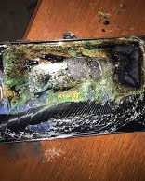
Main Defect:
Battery design flaw: The battery components in the Note 7 were compressed too tightly , causing internal short circuits that led to overheating.

Slide 4

To Fix Problem:
Thorough Investigation: Samsung worked with third-party experts to identify the root cause. They found that the defect originated from both the design and manufacturing process of the batteries.
Improved Testing: Samsung implemented a more rigorous 8-point battery safety check that includes X-ray inspections, durability tests, and charge/discharge tests.
Battery Design Overhaul: They redesigned the battery with better insulation materials and improved spacing between battery components.
Better Communication and Support: Samsung enhanced customer service and communication with users, offering replacements, refunds and educational campaigns on battery safety.

Slide 5
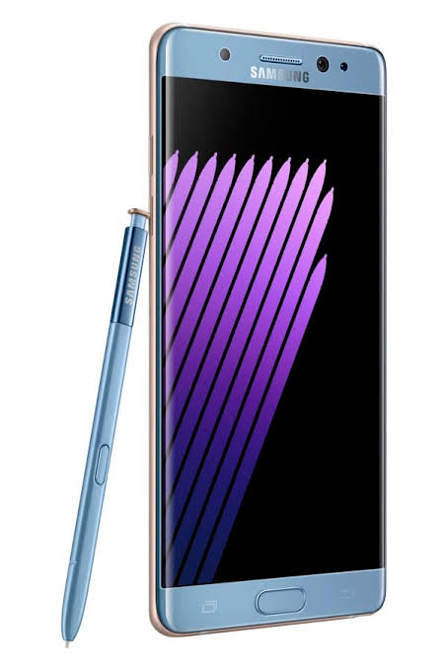
Features of Product:
1.Display:-
5.7-inch Quad HD Super AMOLED screen with a resolution of 2560x1440 pixels.
Always-On Display feature for quick access to notifications without waking the phone.
2.Stylus(S Pen):
Improved S Pen with a finer tip for more precise input.
Pressure sensitivity for drawing and note-taking, mimicking a real pen.
Water-resistant S Pen that worked even on a wet screen.

Slide 6

Features of Product
3.Camera:
12MP rear camera with Dual Pixel technology for faster focusing.
5MP front-facing camera with wide-angle support for better selfies.
Optical Image Stabilization (OIS) for smooth photos and videos.
4.Battery(After Fix):
3,500 mAh battery in the initial model.
After the recall, a safer, smaller battery was introduced with better internal protection and spacing.
5.Performance:
Exynos 8890 or Qualcomm snapdragon 820 processor (depending on the region).
4GB of RAM and 64 GB of internal storage (expandable via microSD card up to 256GB).

Slide 7
Customer Issues
Understand Fear/ Frustration
How Do Customers Feel? Safety, Trust and Reliability Concerns
Acknowledge the problem & Show Concern for Safety
Listen to Customer Feedback and Reports of Incidents
Issue Apologies, Recall Devices, Offer Replacements/Refunds
Provide Safe Solutions, Improve Testing, Ensure Future Safety
Learn from the Incident, Update Processes, Build Trust Back.

Slide 8
TEAM MEMBERS:
Y.DURGA PRASAD
V.PRANAY KUMAR
P.G.VISHWA TEJA
G.ABHILASH REDDY
P.SAI

